Slide 1

UNIVERSITY COLLEGE OF ENGINEERING-BIT CAMPUS TRICHY
Project Members
HARISURIYA A
MUTHAIYAN P
Guided by,
Mrs.SARANYA K

Slide 2
EEG BASED EYE STATE CLASSIFICATION

Slide 3
ABSTRACT
EEG Signals were used to classify the eye state for patients in hospitals.
It is mostly useful for comma patients.
Support Vector Machine(SVM),Logistic regression, Neural Network, LSTM algorithm is used for the classification.

Slide 4
OBJECTIVE
Objective of this project is to classify the eye state of patients using Machine Learning Algorithms.

Slide 5
INTRODUCTION
Brain signals are neuron signals.
The electrical activity of the neurons inside the brain cause electric potential to be generated across different parts of the brain
Different signal values correspond to different mental states.
Different types of states of the brain are due to different types of electrical activities of the brain neurons.

Slide 6
ELECTROENCEPHALOGRAM (EEG)
An Electroencephalogram(EEG) is a test used to evaluate the electrical activity in the brain.
Brain cells communicate with each other through electrical impulses.
An EEG can be used to help detect potential problems associated with this activity.
An EEG tracks and records brain wave patterns

Slide 7
LITERATURE SURVEY
S.NO | TITLE | AUTHOR | YEAR | OUTCOME
1. | Classification of EEG Signals using Support Vector Machine. | K. Sercan Bayram M. Ayyuce Kizrak | 2018 | Improved Accuracy.
2. | Eye State Prediction Using EEG By Supervised Learning | Neha Jain Sandeep Bhargava Dinesh Goyal | 2016 | Enhance the reliability of Eye state
3. | Time series Classification for EEG Eye State Identification based on Incremental Attribute Learning. | Ting Wang T.O. Ting Sheng-Uei Guan | 2017 | Improve accuracy of classification results.

Slide 8
EEG EYE STATE DATA SET
UCI Machine learning Repository -(http://archive.ics.uci.edu/ml/datasets/EEG+Eye+State)
All data is from one continuous EEG measurement with the Emotiv EEG Neuroheadset.
The duration of the measurement was 117 seconds
The eye state was detected via a camera during the EEG measurement.
Then added later manually to the file after analysing the video frames

Slide 9
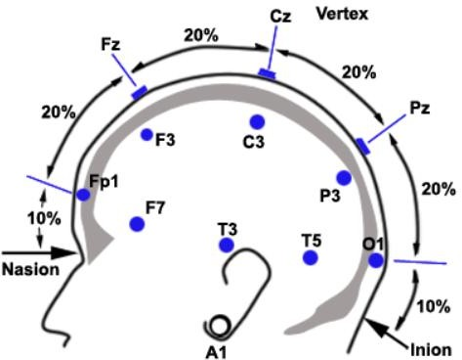
EEG EYE STATE DATA SET
Labels - '1' indicates eye-closed. '0' indicates eye-open.
Input - 14 EEG values
Output - '1' or '0'
Each row consist of 14 EEG values (means 14 time-series values) representing 14 electrodes (TF7, O2, F3, P8, T8, F4, FC6, AF3, FC5, T7, F8, P7, O1 and AF4)

Slide 10
EXISTING SYSTEM
Preprocessing
Input Data
E
Training model
(SVM)
Classification
Evaluation
Evaluation

Slide 11
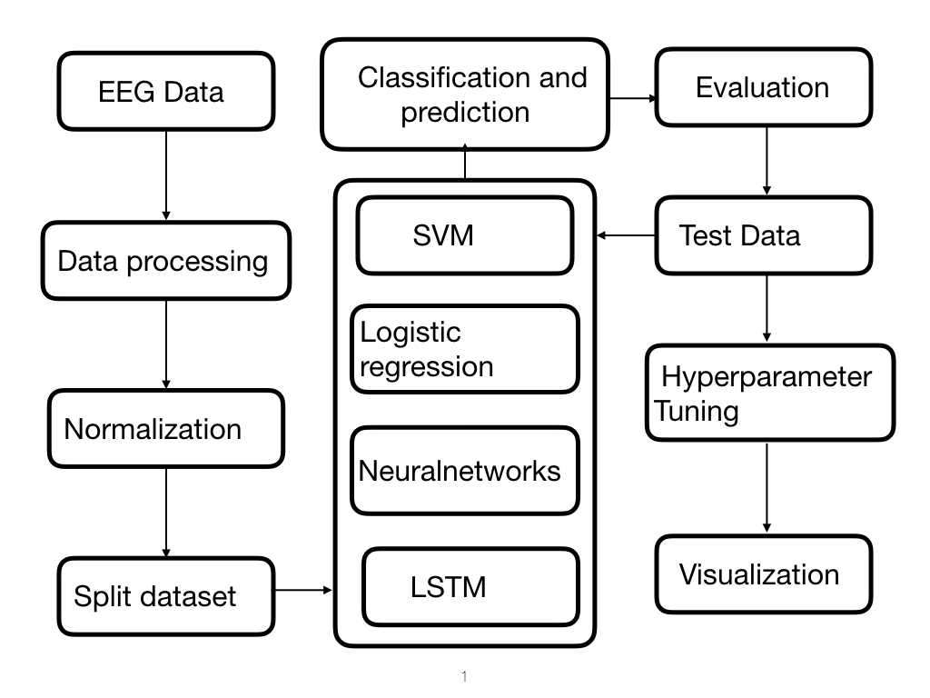
PROPOSED SYSTEM

Slide 12
SUPPORT VECTOR MACHINE
SVM is a Supervised machine learning algorithm
SVM Can be used for Classification and Regression Problems
Plot the Data item as a n-dimensional space (n means no of features )
Then we perform classification by finding the hyper- plane that differentiate the two classes

Slide 13
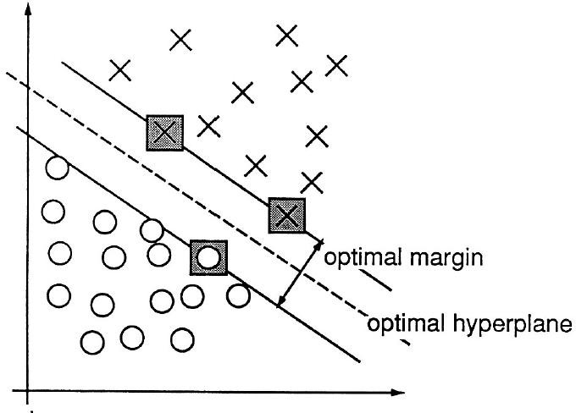
SVM

Slide 14
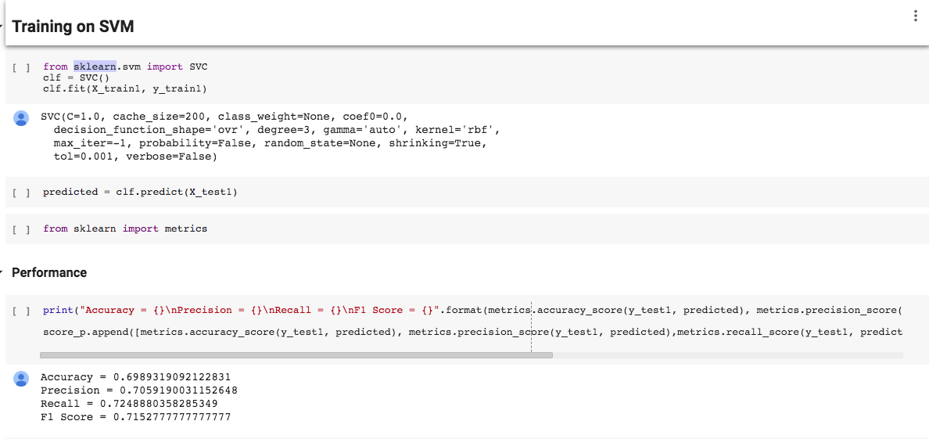
IMPLEMENTATION OF SVM

Slide 15
LOGISTIC REGRESSION
Logistic regression is a Supervised machine Learning Algorithm
Logistic regression is used for classification
Logistic Regression is used when the dependent variable(target) is categorical
It is used to predict a binary outcome (1 / 0, Yes / No, True / False) given a set of independent variables
It use sigmoid for two class classification and uses cross- entropy function as a loss function.

Slide 16
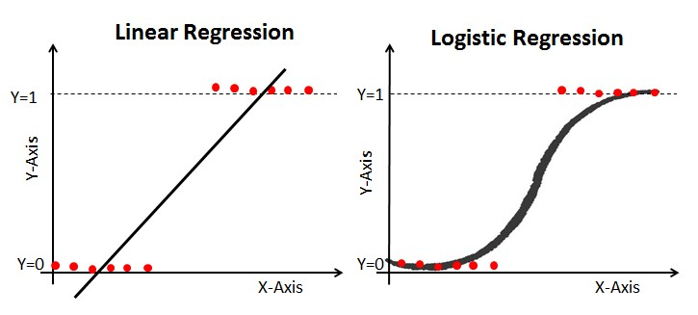
LOGISTIC REGRESSION

Slide 17
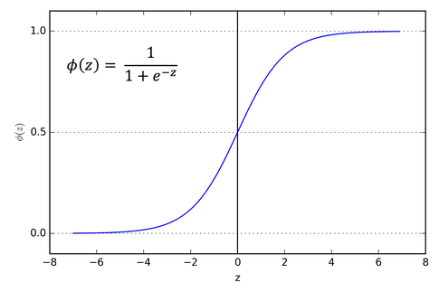
LOGISTIC REGRESSION USING SIGMOID FUNCTION

Slide 18
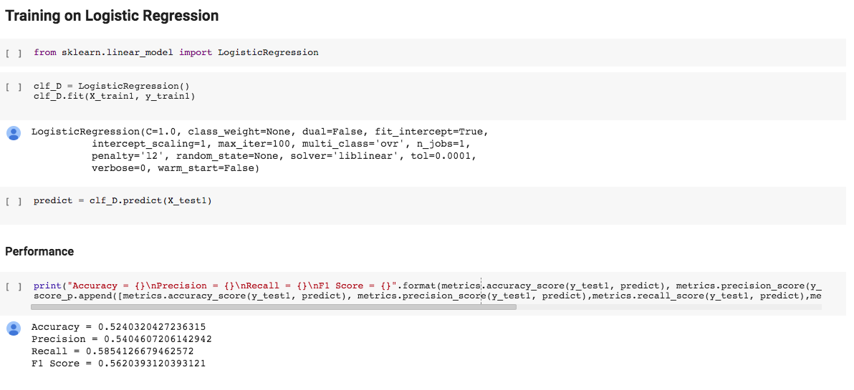
PERFORMANCE OF LOGISTIC REGRESSION

Slide 19
NEURAL NETWORK
ANN randomly assigns weights to all layers then use backpropagation for decreasing the error rate and updating the weights
Backpropagation is a training method used for a multi layer neural network
The training of a neural network by back propagation takes place in three stages
1. Feedforward of the input pattern
2. Calculation and Back propagation of the associated error
3. Adjustments of the weights.

Slide 20
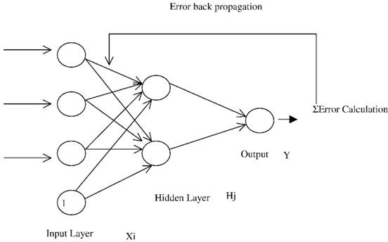
NEURAL NETWORK (Backpropagation)

Slide 21
NEURAL NETWORK
Activation function ― Activation functions are used at the end of a hidden unit to introduce non-linear complexities to the model
Updating weights ― In a neural network, weights are updated as follows: 1: Take a batch of training data. 2: Perform forward propagation to obtain the corresponding loss. 3: Backpropagate the loss to get the gradients. 4: Use the gradients to update the weights of the network.
Dropout- Dropout is a technique meant at preventing overfitting the training data by dropping out units in a neural network.

Slide 22
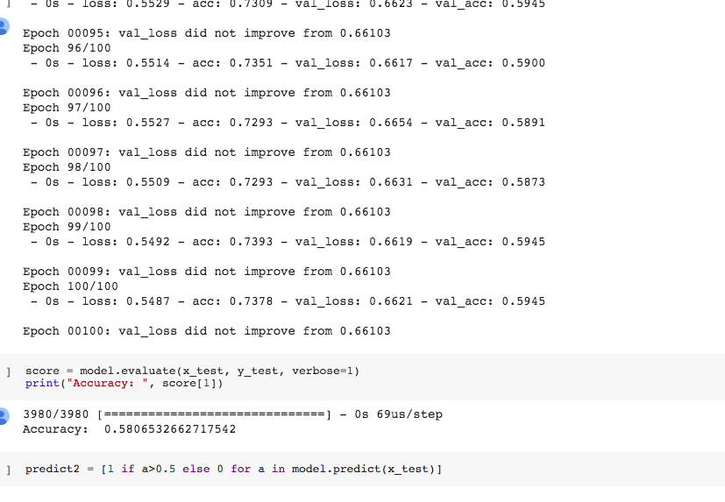
TRAINING NEURAL NETWORK

Slide 23
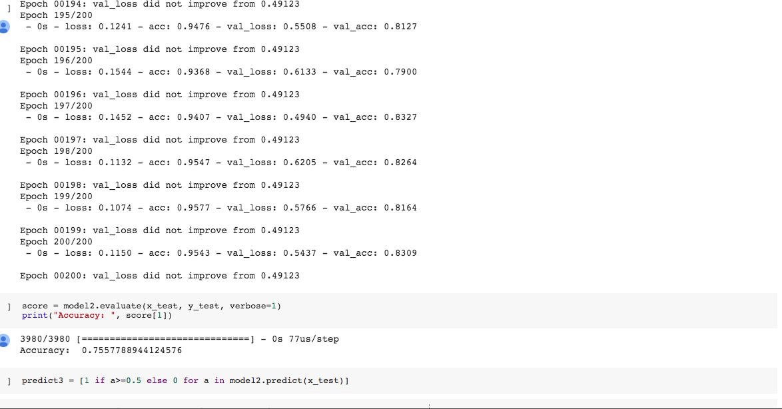
IMPROVED NEURAL NETWORK (HYPER PARAMETER TUNING)

Slide 24
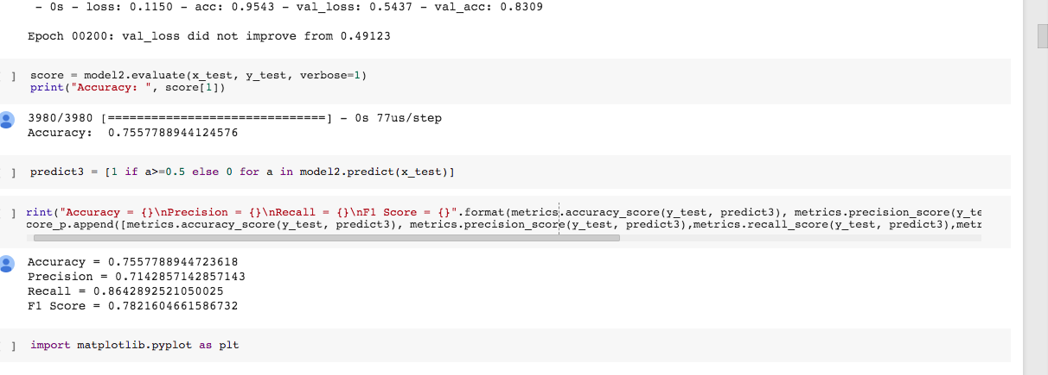
PERFORMANCE OF NN

Slide 25
RECURRENT NEURAL NETWORK
Recurrent neural network is one of the type of Artificial Neural Network
RNN stores inputs temporarily to predict what coming next.
RNN add the immediate past to the present.
RNN has two input
1.present
2.recent past
Application –Googles Voice search, Apple siri

Slide 26
LONG-SHORT TERM MEMORY
LSTM is an extension for RNN
LSTM enable RNN’s to remember their input over long period of time
LSTM has three gates
Input gate (input)
Forget gate (delete the because it isn’t important )
Output gate(output at the current time step)
LSTM It over come the vanishing gradient problem

Slide 27
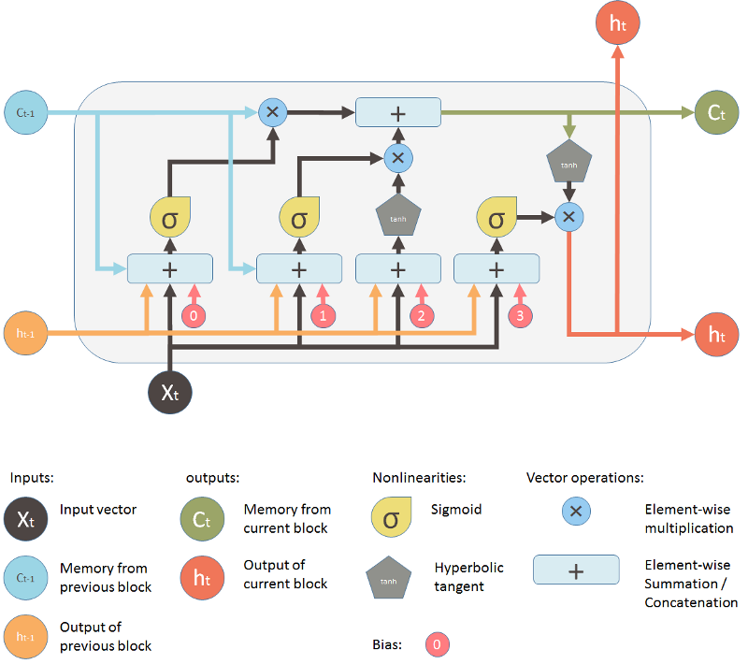
LSTM

Slide 28
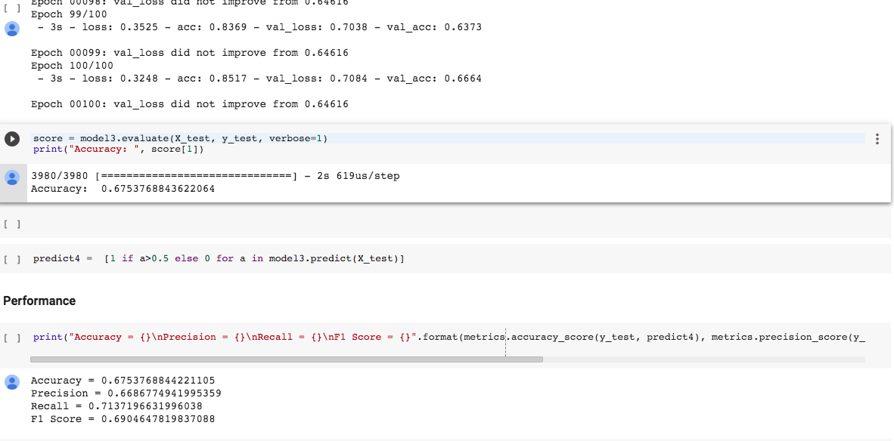
TRAINING LSTM

Slide 29
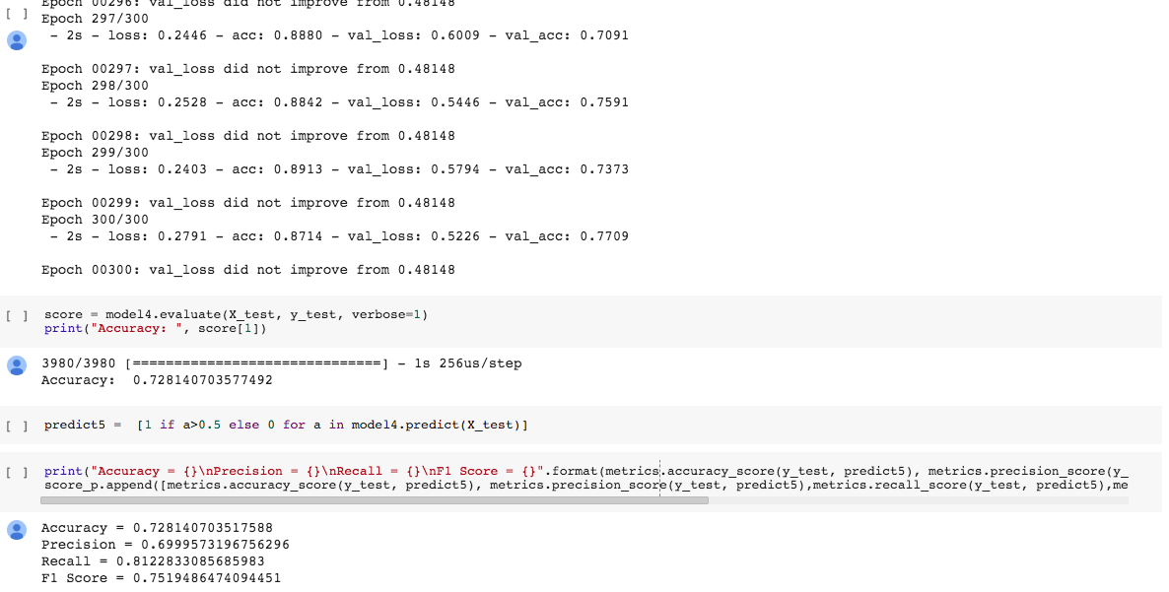
PERFORMANCE OF LSTM

Slide 30
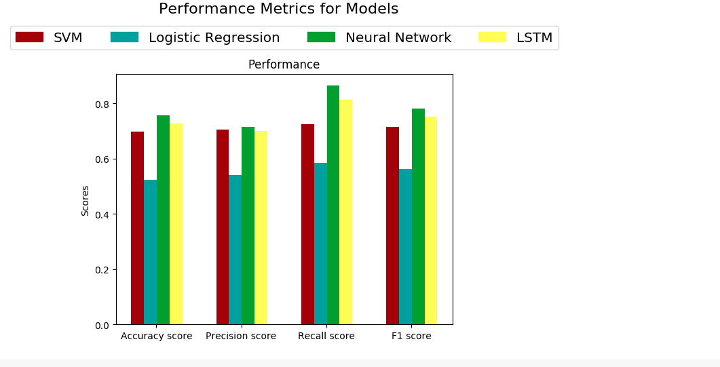

Slide 31
THANK YOU

